Slide 1
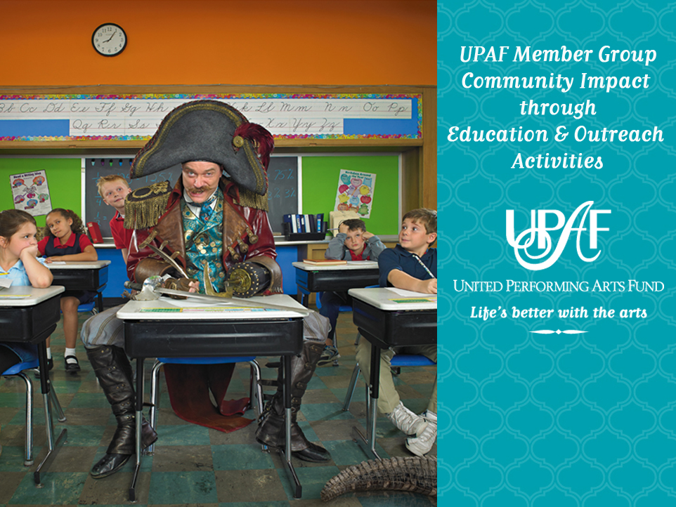

Slide 2

What is UPAF?
United Performing Arts Fund (UPAF) is a nonprofit, umbrella organization that supports 34 performing arts groups in Southeastern Wisconsin through its annual fundraising campaign.
UPAF raises funds through a community-wide based approach, receiving contributions from over 21,000 donors and over 400 corporations in 2010.
UPAF raises over $9 million annually
UPAF has provided over $224 million in unrestricted operating support to the performing arts over its 44 year history.
UPAF Member Groups provide over 2,000 local performances each year
UPAF Member Groups reach over 1 million people through educational programming, community outreach and performances

Slide 3



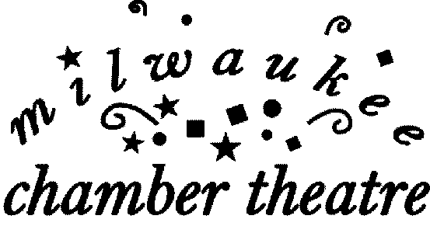










UPAF Member Groups

Slide 4

2011 UPAF Affiliate Groups
Boulevard Ensemble Studio Theatre
DanceCircus
Festival City Symphony
Frankly Music
In Tandem Theatre
Kenosha Symphony Association
Ko-Thi Dance Company
Latino Arts
Milwaukee Chamber Orchestra
Milwaukee Choral Artists
Milwaukee Opera Theatre
North Shore Academy of the Arts
PianoArts of Wisconsin
Racine Symphony Orchestra
Sunset Playhouse
Theatre Gigante
Wild Space Dance Company
Windfall Theatre
Wisconsin Philharmonic

Slide 5
Participation in the performing arts has been shown to improve children’s confidence, focus and test scores which helps students succeed in the classroom, and beyond.
UPAF Member Groups help educate 400,000 area youth each year, helping to fill the gap created by recent school budget cuts.
Your support of UPAF allows our Member Groups to create community and touch the lives of not only children, but also the elderly, abused and disabled.

Slide 6


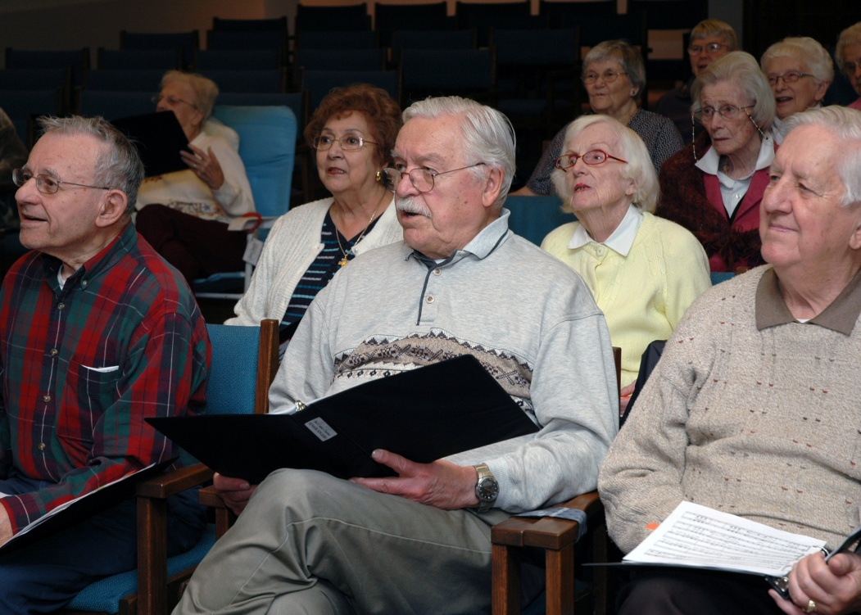
The Bel Canto Chorus Senior Singers outreach program continues to be a leading example of the possibility for the performing arts to enhance the lives of their community members – regardless of age. Bel Canto Music Director Richard Hynson initiated a 3-year study to measure the impact of cultural programs on older adults who participated in the program and found clear differences in the health of the seniors including improved vision, breathing and posture, and fewer doctor visits.

Slide 7

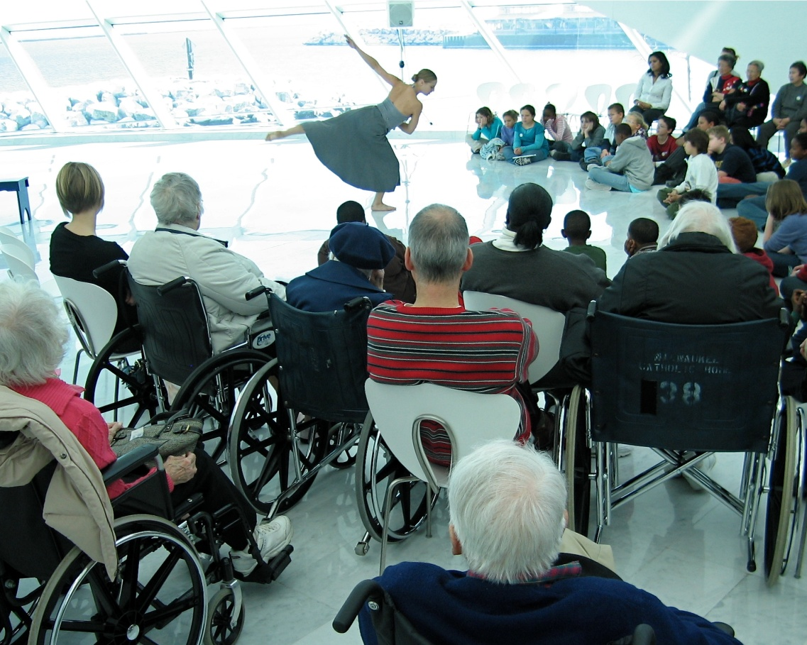
Danceworks’ Intergenerational Multi-Arts Project (IMAP) is offered at 7 senior citizen sites with 7 neighboring site schools introduces participants to a range of artistic expression while encouraging creative thinking and problem solving across generations and subject boundaries.

Slide 8

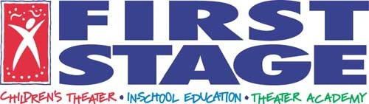
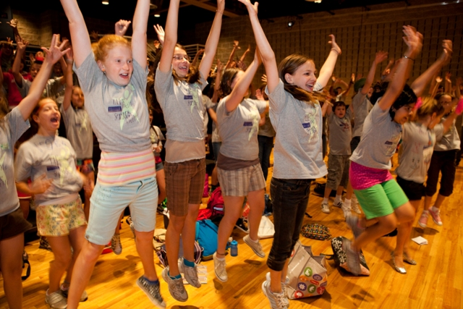
Designed to “open new doors for City of Milwaukee youth,” the First Stage Children’s Theater Community Partnership Program (CPP) is committed to making arts education accessible to all children in our community regardless of socioeconomic circumstances. CCP uses the power of theater arts to nurture the positive personal development and academic advancement of City of Milwaukee children.

Slide 9

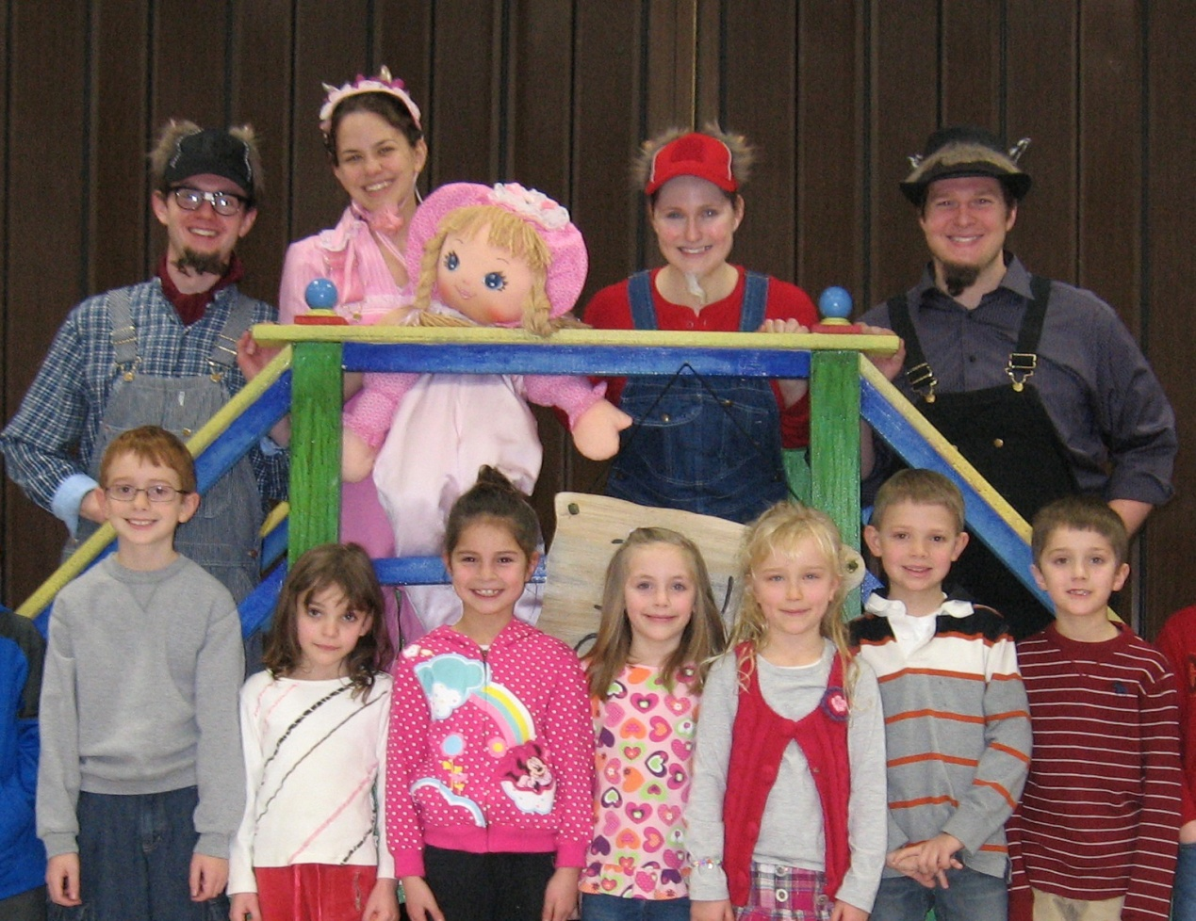
Florentine Opera Company’s in-school children’s opera, The Billy Goats Gruff, Opera Inside Out, and the High School Masterclass are designed to both meet the state’s required learning targets, as well as provide vast opportunities for cross-curricular learning. These programs make opera experiences available to students at Milwaukee Public Schools, throughout Greater Milwaukee and around the state.

Slide 10

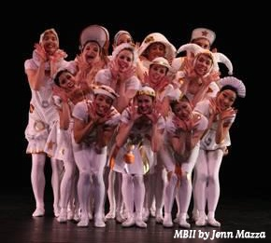
As the only professional studio school in the Midwest to be accredited by the National Association of Schools of Dance, the Milwaukee Ballet School is allowed to admit international students. They currently have 7 international students enrolled in the MBII program from Australia, Japan, the Philippines and Brazil.

Slide 11
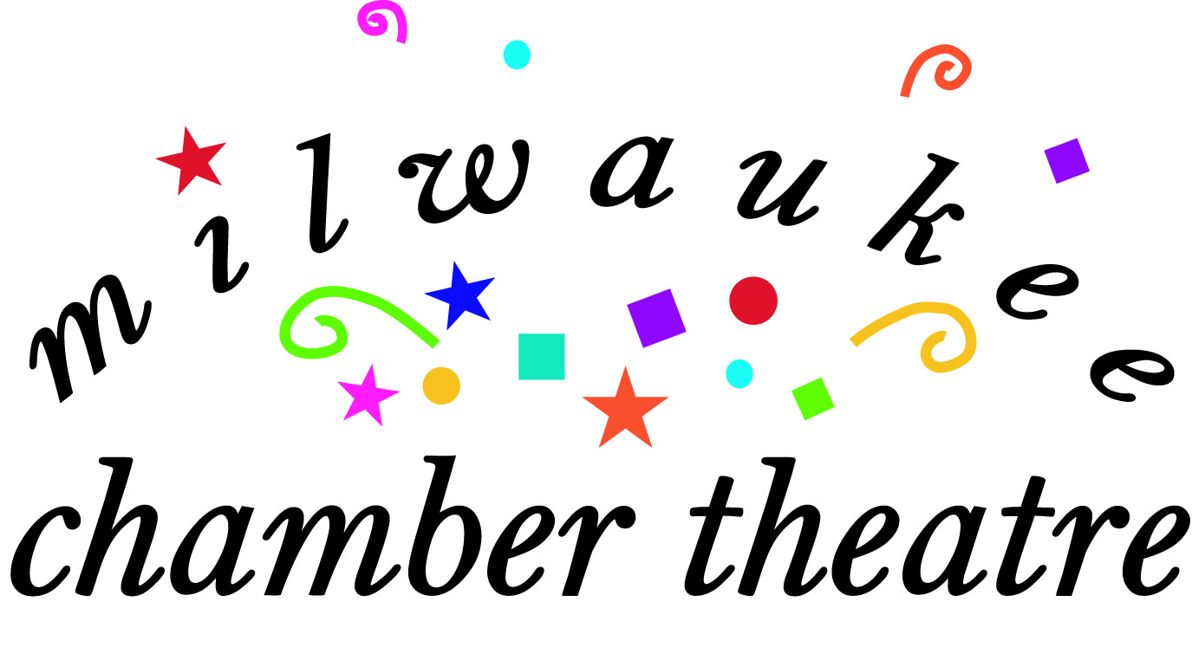
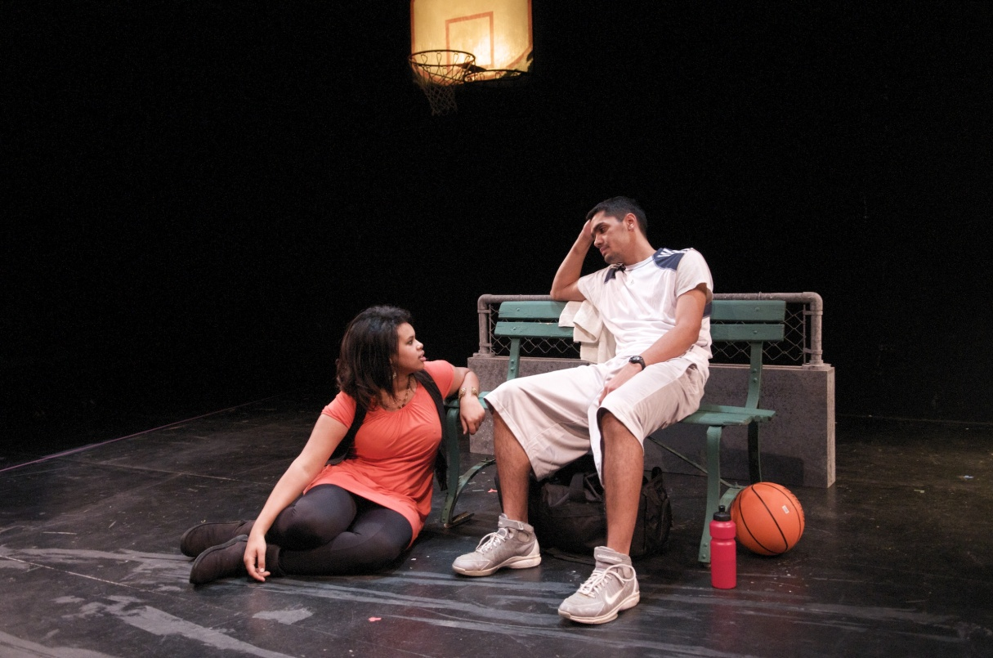
For the 09-10 season the Milwaukee Chamber Theatre’s program, the Young Playwrights Festival (YPF) was able to offer free playwriting workshops to participating high school students. This writing competition is designed to encourage high school students to explore themes and relationships through the writing of a one-act play.

Slide 12
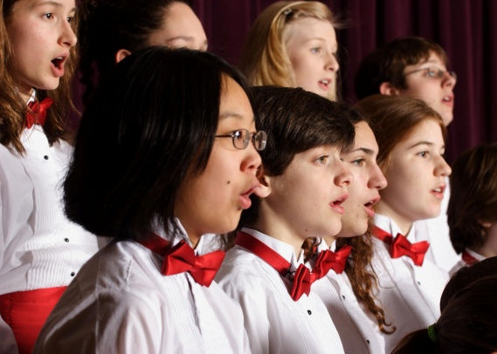
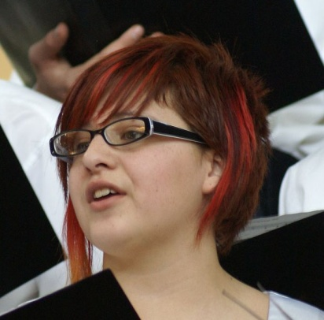
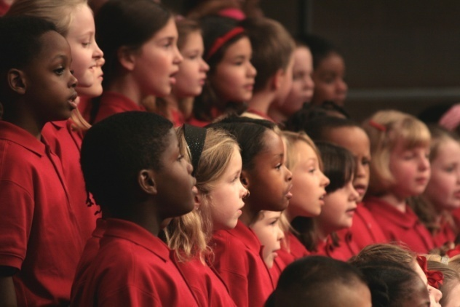
Milwaukee Children’s Choir members come from seven counties. They represent grades K4-12 from more than 140 schools. MCC has five choir levels and 13 rehearsal sites. MCC teaches through performance and will present five performances during the 2010-2011 season.

Slide 13

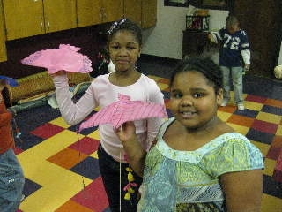
Milwaukee Public Theatre more than tripled its number of arts residencies at local schools and community based organizations from 15 to 55 (32 schools and 23 organizations) demonstrating how local arts organizations are filling the growing gap in school-generated arts programming. Their in-school programming reached over 23,000 children last year.

Slide 14

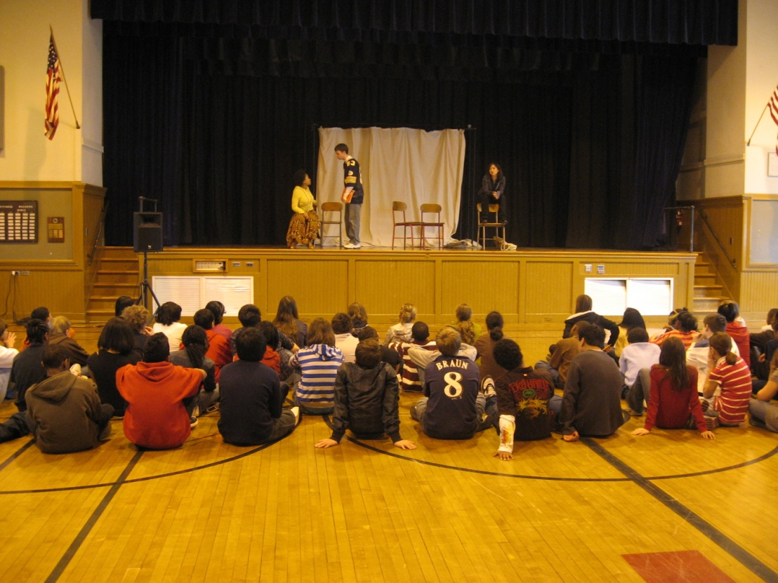
Milwaukee Repertory Theater’s touring shows and school outreach programs reached 18, 500 children (primarily in Milwaukee but also in places like Veroqua, Janesville, Sturgeon Bay and Ashwaubenon) last season.

Slide 15

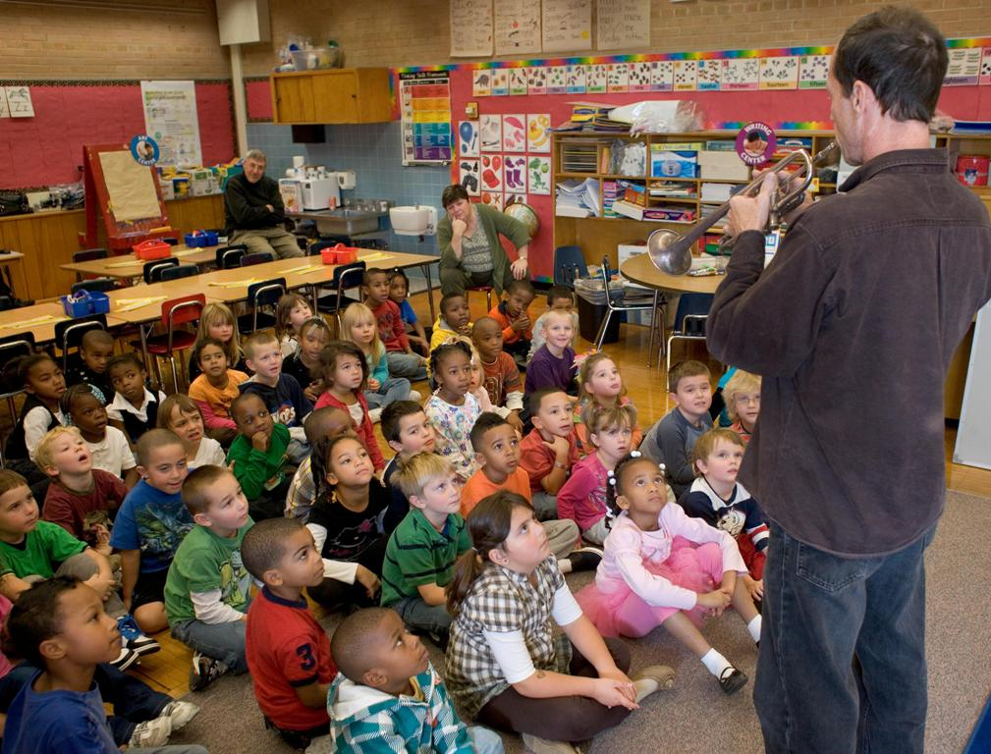
In its 21st year, the Milwaukee Symphony Orchestra’s nationally recognized Arts in Community Education (ACE) program integrates arts education into state-required curricula, providing arts opportunities for students when budget cuts are eliminating music and arts programming. Classrooms receive three visits per year by ensembles of MSO musicians and artists from local arts organizations, MSO concert experiences, as well as lesson plans and supporting materials reaching over 7,500 students in 21 southeastern Wisconsin schools – 11 of which are Milwaukee Public Schools.
.

Slide 16

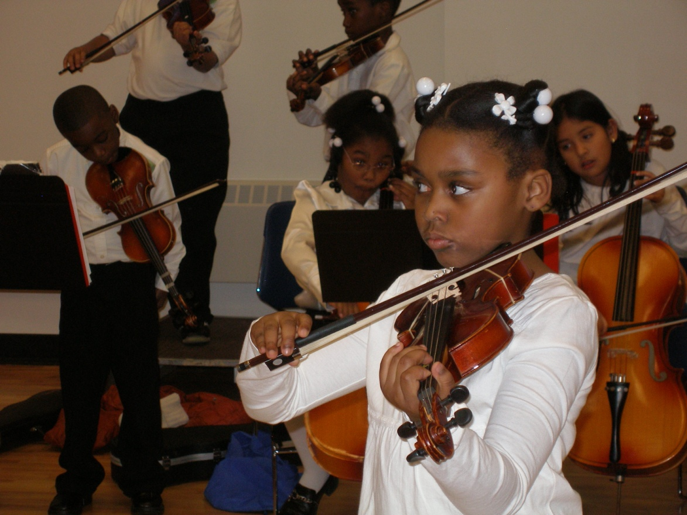
Milwaukee Youth Symphony Orchestra continues to draw praise as the largest, by several measures, and one of the finest youth orchestra programs in the country. They continue to focus on diversifying their membership by developing and specializing their introductory programming, scouting talent at school concerts, offering scholarships, private teachers and regular phone contact with parents to ensure success. MSYO has also become a leading advocate for keeping music programs in schools.
.

Slide 17

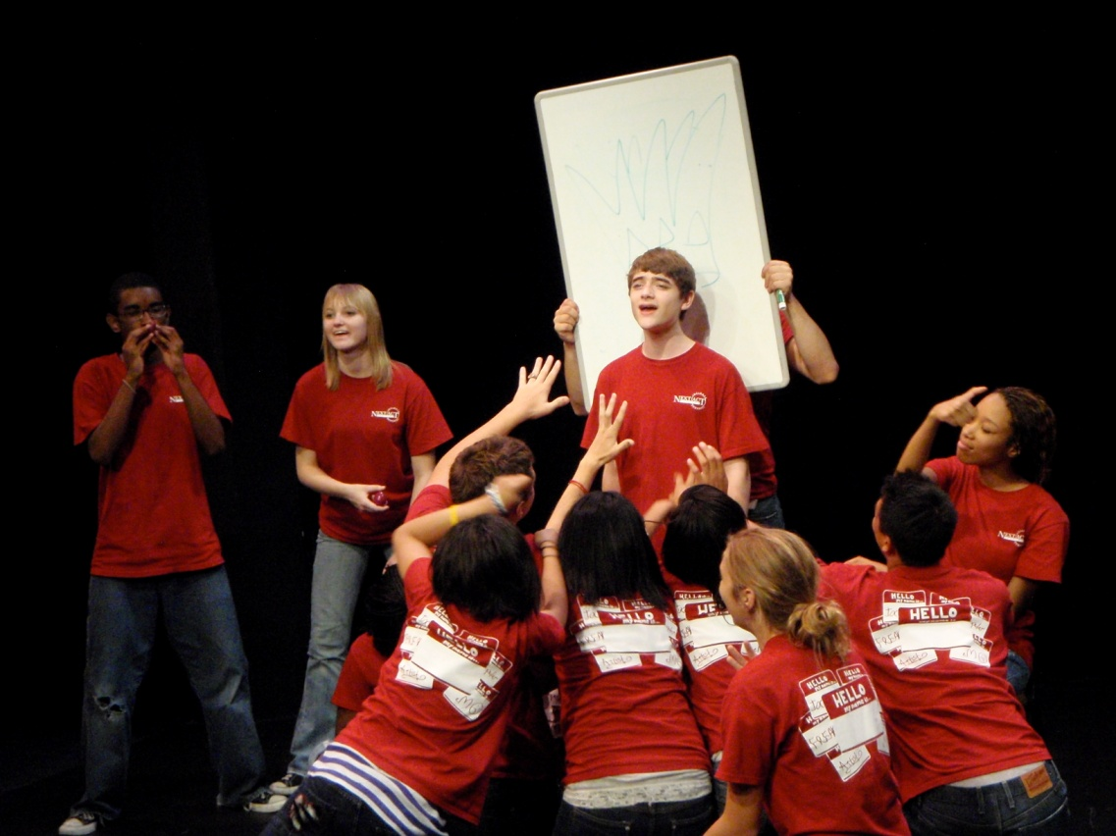
2010 marks the twelfth year that Next Act Theatre has offered the Summer Theatre for Teens six-week theatre program offered free of charge to 20 Milwaukee area teens, allowing them the opportunity to work side by side with professional artists to create an original hour-long musical theatre piece. Along with arts education, this unique program emphasizes creativity, collaboration and mutual respect.

Slide 18

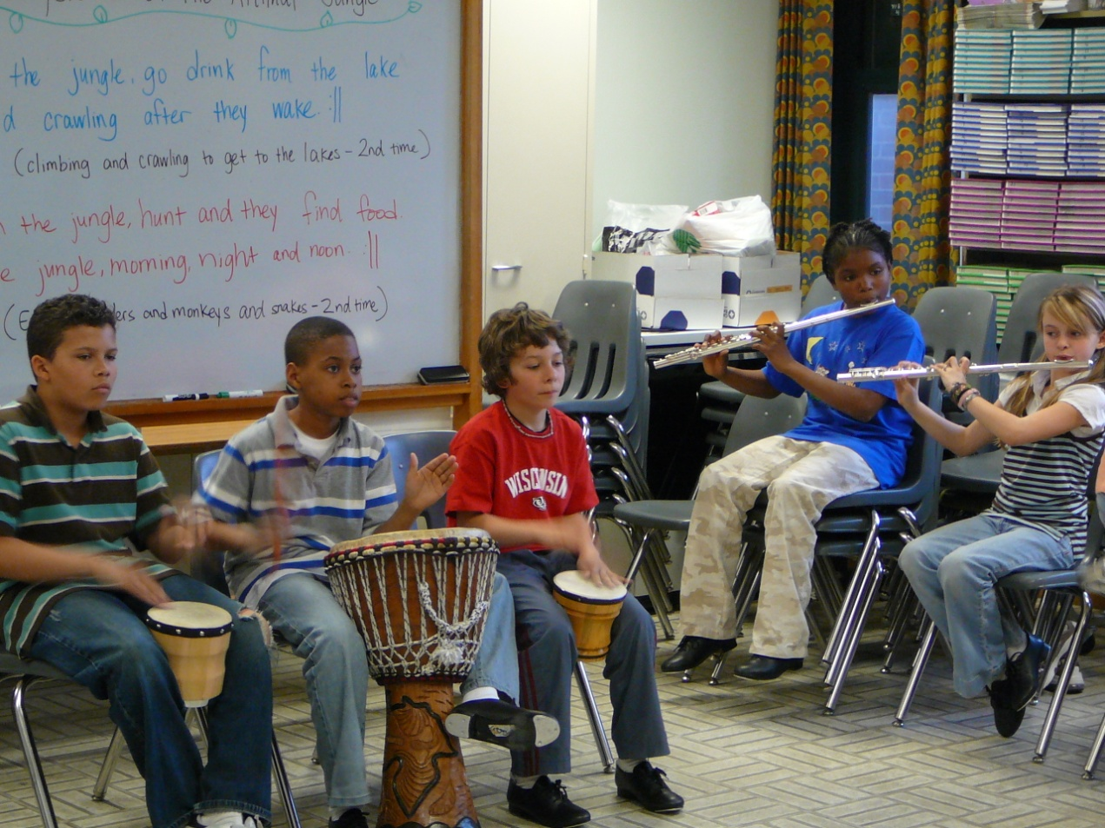
Last year, Present Music’s Creation Project residency program taught more than a hundred students to be the composer of their own original works, which were then premiered by nearly a thousand student musicians for audiences made up of the students’ parents teachers and peers.

Slide 19
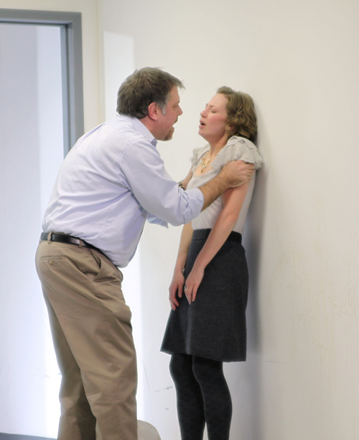
Renaissance Theaterworks collaborated with the Sexual Assault Treatment Center of Aurora Health Care and their affiliate The Healing Center to provide expertise for talkbacks following their production of Blackbird and hosted a free performance for staff and clients of the center to facilitate much-needed dialogue on the generally taboo subject of sexual abuse.

Slide 20

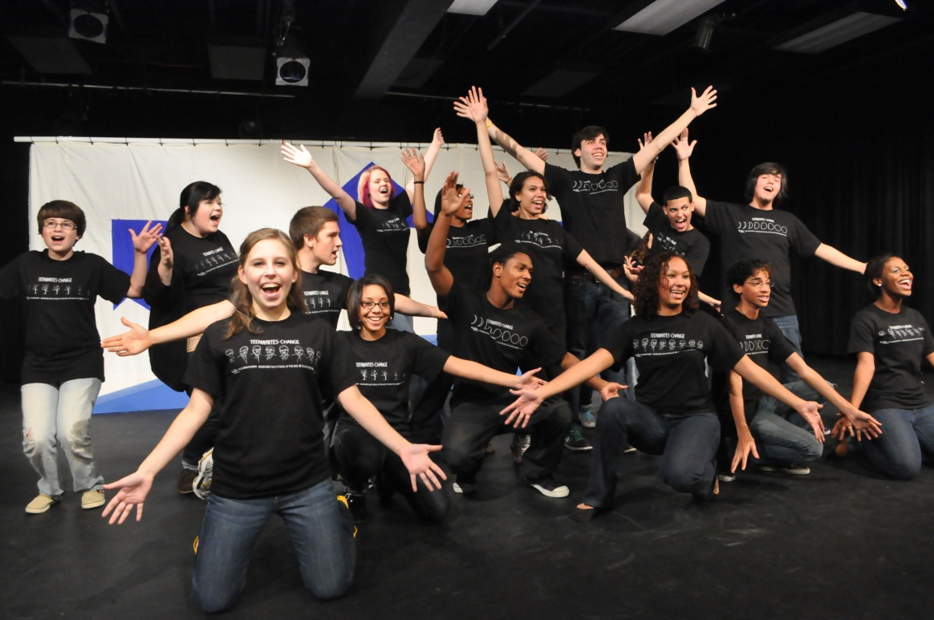
Skylight Opera Theatre’s Enlighten program served nearly 13,000 students from 68 schools in 2009-2010. Their TeenWrites program with Milwaukee High School of the Arts featured a highly successful collaboration and exchange with students from England this past year which culminated in a performance.

Slide 21
